Slide 1
2013 FISHING CONTESTS

Slide 2
THANK YOUS
CAUSEWAY BAIT & TACKLE
Sponsoring the Children’s Division
Donations to LIBBA
BOB’S BAIT & TACKLE
Donations to LIBBA
LUNKERTIP.COM
Donations to the Children’s Division
PAULIES BAIT & TACKLE
Donations to LIBBA

Slide 3
LIBBA CONTESTS
KEN KARWICK MEMORIAL CONTEST
Striped Bass, Bluefish & Weakfish
Men’s, Women’s, Youth & Children Divisions
Top 3 fish in each category
Special prizes
Largest released striper
Hidden weight
Exceptional fish
MONTAUK & SOUTH SHORE DERBIES
Striped Bass & Bluefish
Top 3 fish in each category

Slide 4
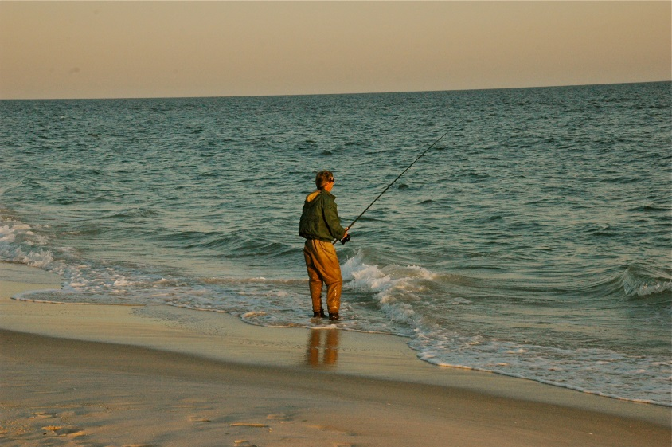
2013 HIGHLIGHTS (AND LOWS)
At times surf fishing was hard
Our boat brethren seemed to do well
Entered fish
16 striped bass
12 bluefish
1 weakfish
About the same number of bass as 2012
One had to work hard to find them
A lot less blues
They seemed to disappear after mid Oct.
Only 1 weakfish
Yet they were around much of the summer
Montauk Derby was “tough”
Only 2 fish entered
South Shore Derby was hard to find striped bass

Slide 5
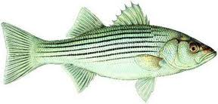
KEN KARWICK CONTEST WINNERS
MEN'S | Mem. # | Wgt
Joe Kelly | 571 | 31 T
Paul Knorr | 1199 | 30.72 T
Chris Sippel | 1421 | 30
Andy Richman | 346 | 28
WOMEN'S
Barbara Kehlenbeck | 164 | 18.7
YOUTH
Matt Malenovsky | 587 | 22
Matt Malenovsky | 587 | 20
Matt Malenovsky | 587 | 16
CHILDREN'S
Riley George | 447 | 12
STRIPED BASS

Slide 6
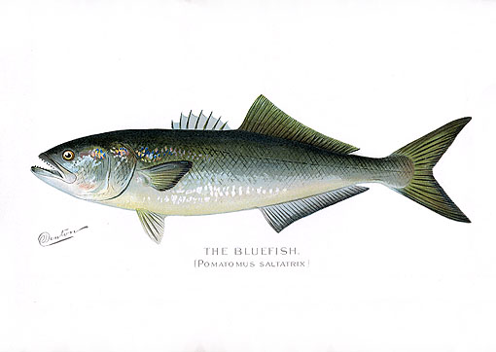
KEN KARWICK CONTEST WINNERS
MEN'S | Mem. # | Wgt
Barry Barone | 2094 | 16.1
John Citarella | 1655 | 15.06 T
Tom Kehlenbeck | 163 | 14.9 T
Kevin Donahue | 294 | 15 T
Bill Davison | 1972 | 14.74 T
WOMEN'S
Barbara Kehlenbeck | 164 | 12.4
YOUTH
Matt Malenovsky | 587 | 7
CHILDREN'S
BLUEFISH

Slide 7
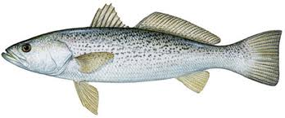
KEN KARWICK CONTEST
WEAKFISH
MEN'S | Mem. # | Wgt
Tom Kehlenbeck | 163 | 5.25
WOMEN'S
YOUTH
CHILDREN'S

Slide 8
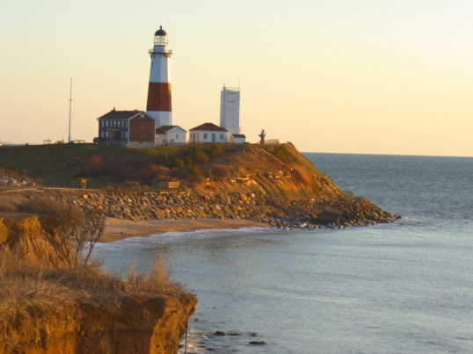
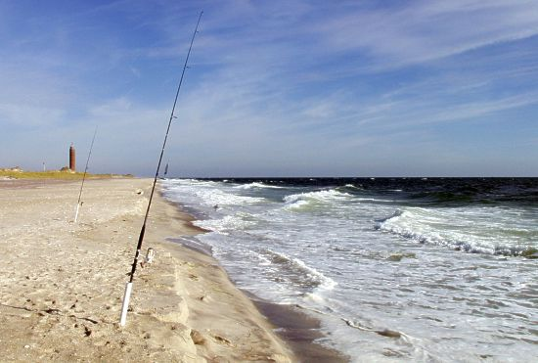
THE DERBIES
SOUTH SHORE DERBY
Striped Bass | Mem # | Wgt
Jeffrey Collins | 1170 | 21.7
Matt Malenovsky | 587 | 16
Bluefish
Barry Barone | 2094 | 16.1
Jeffrey Collins | 1170 | 11.24
Bill Smith | 457 | 7
MONTAUK DERBY
Striped Bass | Mem # | Wgt
Jeffrey Collins | 1170 | 21.7
Matt Malenovsky | 587 | 16
Bluefish
Barry Barone | 2094 | 16.1
Jeffrey Collins | 1170 | 11.24
Bill Smith | 457 | 7

Slide 9
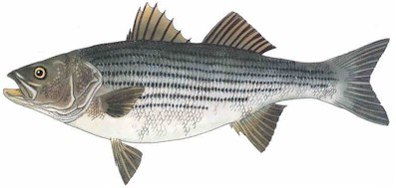
LARGEST RELEASED STRIPED BASS
Chris Sippel 1421 30

Slide 10
HIDDEN WEIGHT
All weight slips that are entered are eligible
Now to pick the winning name

Slide 11
2014 LOU FARR MEMORIAL LIBBA MEMBERS CONTEST
Goals
Increase LIBBA membership
Improve LIBBA finances
Cash prizes, ie. $1000 1st prize
Between Montauk & SS Derbies
Need volunteers to make this work
Seeking corporate sponsor
Please see me afterwards or email me (on website)

Slide 12
REMEMBER TO ENTER YOUR FISH IN 2014!!!!!
Weigh slips are on the website
Contest runs April 1 to Dec 15
All slips must be postmarked by Dec 31

